Slide 1
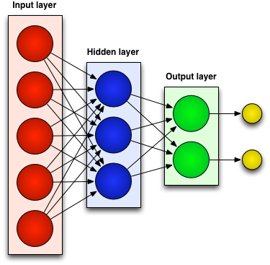
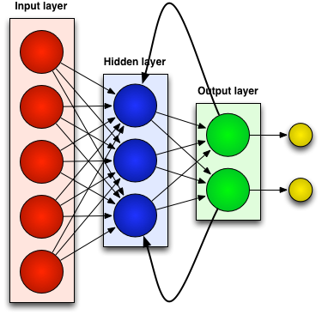
Neural Networks
Generally there are two kinds of neural networks:
Feedforward Neural Networks:
connections between the units do not form a cycle
Recurrent Neural Network:
connections between units form cyclic paths
Notes:
In recent years, neural networks composed of multiple layers, which are often termed as Deep Learning, have emerged as a powerful machine learning approach.
A feedforward neural network is an artificial neural network where processing of information is piped through the network from input layers to output layers.
In contrast, a recurrent neural network (RNN) is an artificial neural network where connections between units form cyclic paths.

Slide 2
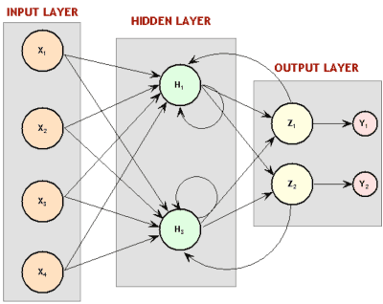
Recurrent Neural Network (RNN)
Recurrent since they receive inputs, update the hidden states depending on the previous computations, and make predictions for every element of a sequence.
RNNs are a neural network with memory.
RNNs are very powerful dynamic system for sequential tasks such as speech recognition or handwritten recognition since they maintain a state vector that implicitly contains information about the history of all the past elements of a sequence.
Notes:
RNNs are called recurrent …
We can consider RNNs as …
RNNs are very …

Slide 3
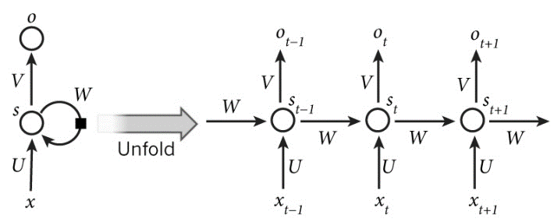



Unrolling an RNN for Sequential Modeling
An unrolled RNN (in time) can be considered as a deep neural network (DNN) with indefinitely many layers:
$x_{t}$: input at time $t$
$s_{t}$: hidden state at time $t$ (memory of the network).
$f$: is an activation function (e.g, $tanh()$ and ReLUs).
U, V, W: network parameters (unlike a feedforward neural network, an RNN shares the same parameters across all time steps).
g: activation function for the output layer (typically a softmax function).
y: the output of the network at time $t$
$$s_{t}=f\left(Ux_{t}+Ws_{t−1}\right)$$
$$\left.y=g(Vs_{t}\right)$$
Notes:
Common choices for $f$ are tanh and ReLUs. $S_{−1}$ which is required to initialize the first hidden state is typically set to all zeroes.
The output of the network is $y$ which is calculated by a nonlinear function of matrix multiplication of V and $S_{t}$. g, is the activation function for the output layer.
Unlike feed forward neural networks, which have different parameters at each layer, a RNN shares the same parameters (U, V, W in Eq. 2.1 and Eq. 2.2) across all steps.

Slide 4
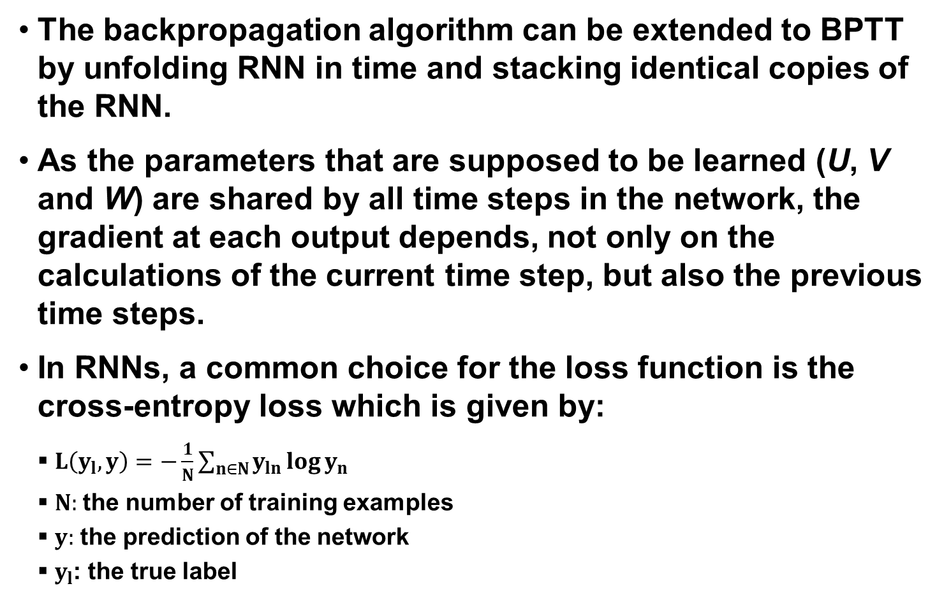
Backpropagation Through Time
The backpropagation algorithm can be extended to BPTT by unfolding RNN in time and stacking identical copies of the RNN.
As the parameters that are supposed to be learned (U, V and W) are shared by all time steps in the network, the gradient at each output depends, not only on the calculations of the current time step, but also the previous time steps.
In RNNs, a common choice for the loss function is the cross-entropy loss which is given by:
$L\left(y_{l},y\right)=−\frac{1}{N}\sum_{n∈N}{y_{ln}\log{y_{n}}}$
$N:$the number of training examples
$y:$ the prediction of the network
$y_{l}$: the true label
Notes:
The backpropagation algorithm can be extended to BPTT by unfolding RNN in time and stacking identical copies of the RNN.
As the parameters that are supposed to be learnt (U, V and W) are shared by all time steps in the network, the gradient at each output depends not only on the calculations of the current time step, but also the previous time steps.

Slide 5
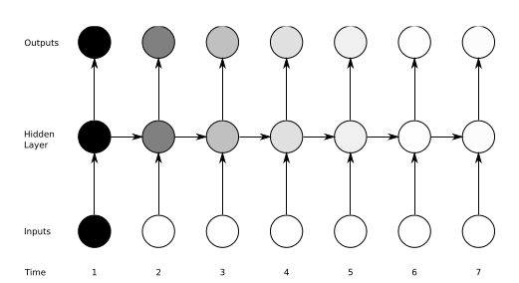
The Vanishing Gradient Problem
Definition: The influence of a given input on the hidden layer, and therefore on the network output, either decays or grows exponentially as it propagates through an RNN.
In practice, the range of contextual information that standard RNNs can access are limited to approximately 10 time steps between the relevant input and target events.
Solution: LSTM networks.
Notes:
While RNNs are powerful structures, they are hard to train.
One of the main reason is “vanishing gradient problem” which explored in depth by Bengio and it refers to
They found that in theory RNNs can make use of information in arbitrarily long sequences, but in practice they are limited to looking back only a few steps.

Slide 6
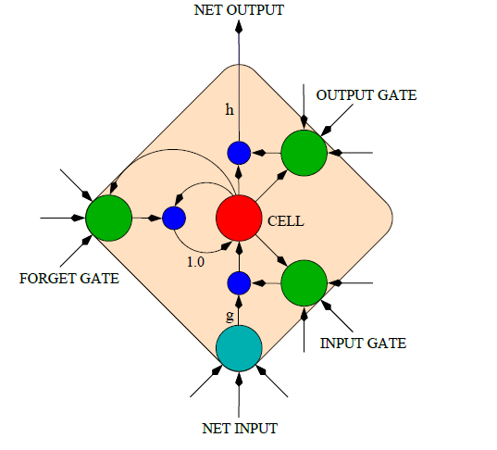
LONG SHORT-TERM MEMORY (LSTM)
An LSTM is a special kind of RNN architecture, capable of learning long-term dependencies.
An LSTM can learn to bridge time intervals in excess of 1000 steps.
This is achieved by multiplicative gate units that learn to open and close access to the constant error flow.
LSTM Memory Cell
Notes:
Long Short Term Memory networks are a special kind …

Slide 7
Memory Cell in LSTM
LSTM networks introduce a new structure called a memory cell.
Each memory cell contains four main elements:
Input gate
Forget gate
Output gate
Neuron with a self-recurrent
These gates allow the cells to keep and access information over long periods of time.
LSTM Memory Cell

Slide 8
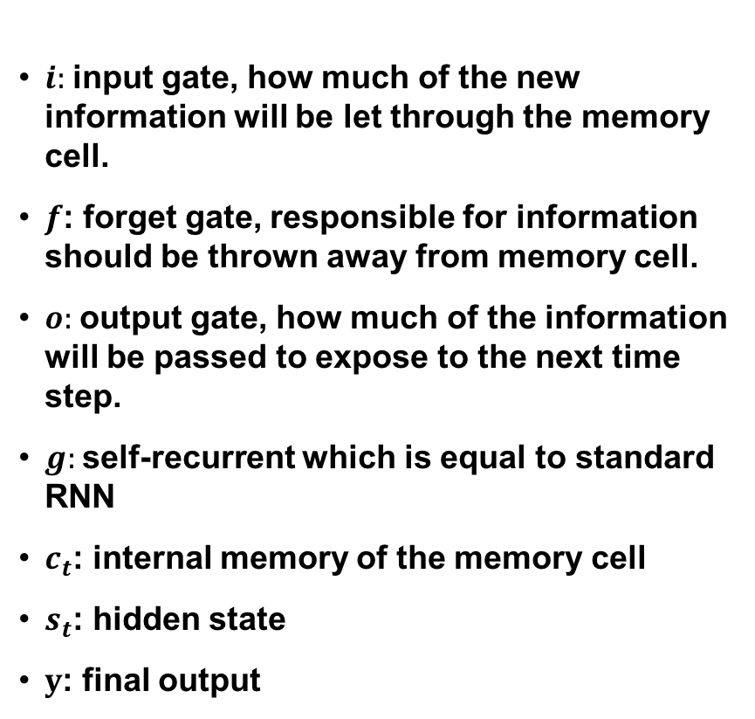
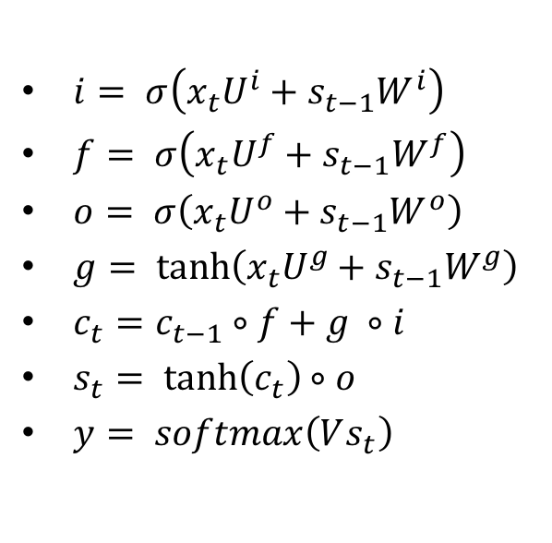
LSTM Equations
$i:$input gate, how much of the new information will be let through the memory cell.
$f$: forget gate, responsible for information should be thrown away from memory cell.
$o:$output gate, how much of the information will be passed to expose to the next time step.
$g:$self-recurrent which is equal to standard RNN
$c_{t}$: internal memory of the memory cell
$s_{t}$: hidden state
$y$: final output
$i= σ\left(x_{t}U^{i}+s_{t−1}W^{i}\right)$
$f= σ\left(x_{t}U^{f}+s_{t−1}W^{f}\right)$
$o= σ\left(x_{t}U^{o}+s_{t−1}W^{o}\right)$
$g= \tanh\left(x_{t}U^{g}+s_{t−1}W^{g}\right)$
$c_{t}=c_{t−1}∘f+g ∘i$
$s_{t}= \tanh\left(c_{t}\right)∘o$
$y= softmax\left(Vs_{t}\right)$
LSTM Memory Cell

Slide 9
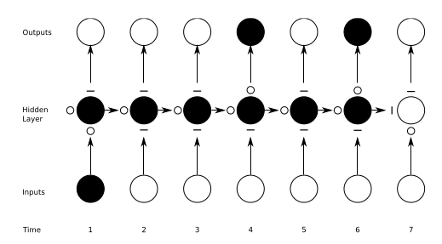
Preserving the information in LSTM
A demonstration of how an unrolled LSTM preserves sequential information.
The input, forget, and output gate activations are displayed to the left and above the memory block (respectively). The gates are either entirely open (‘O’) or entirely closed (‘—’).
Traditional RNNs are a special case of LSTMs: Set the input gate to all ones (passing all new information), the forget gate to all zeros (forgetting all of the previous memory) and the output gate to all ones (exposing the entire memory).

Slide 10
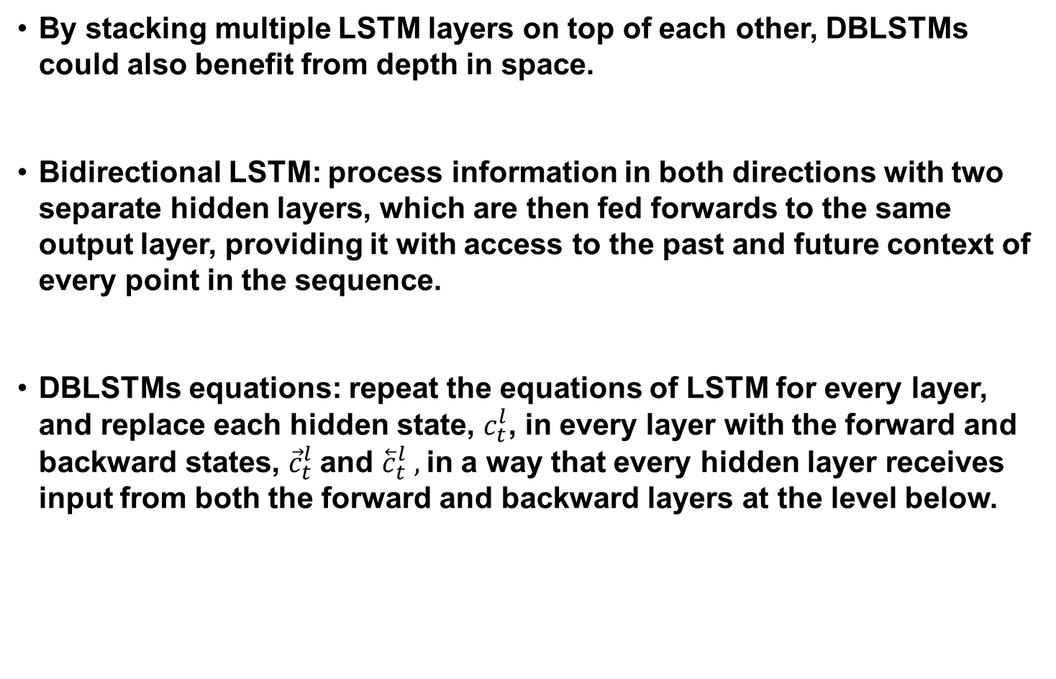
Deep Bidirectionsal LSTMs (DBLSTM)
By stacking multiple LSTM layers on top of each other, DBLSTMs could also benefit from depth in space.
Bidirectional LSTM: process information in both directions with two separate hidden layers, which are then fed forwards to the same output layer, providing it with access to the past and future context of every point in the sequence.
DBLSTMs equations: repeat the equations of LSTM for every layer, and replace each hidden state, $c_{t}^{l}$, in every layer with the forward and backward states, ${\vec{c}}_{t}^{l}$and ${\overset{⃖}{c}}_{t}^{l} ,$in a way that every hidden layer receives input from both the forward and backward layers at the level below.
Notes:
One of the greatest disadvantageous of RNN and LSTM structures that were introduced in part 1 and 2, is that they are processing information just based on the previous context.
In a lot of application including speech recognition, we prefer another structure called bidirectional LSTM (BLSTM) which can …
BLSTMs contain two separate hidden layers, one of them processes the input sequence forwards, while the other processes it backwards. Both hidden layers are connected to the same output layer, providing it with access to the past and future context of every point in the sequence.

Slide 11
An overview of gradient descent optimization algorithms
1) SGD Reference:http://ufldl.stanford.edu/tutorial/supervised/OptimizationStochasticGradientDescent/
2) RMSprop Reference:http://www.cs.toronto.edu/~tijmen/csc321/slides/lecture_slides_lec6.pdf)
3) Adagrad Reference: http://jmlr.org/papers/v12/duchi11a.html
4) Adadelta Reference: https://arxiv.org/abs/1212.5701
5) Adam Reference: http://arxiv.org/abs/1412.6980v8
6) Adamax Reference: https://arxiv.org/abs/1412.6980v8
7) Nadam Reference: http://cs229.stanford.edu/proj2015/054_report.pdf
Notes:
.

